Slide 1
Product Management
Erfan Memarpour
Project Name : Dr Shop

Slide 2
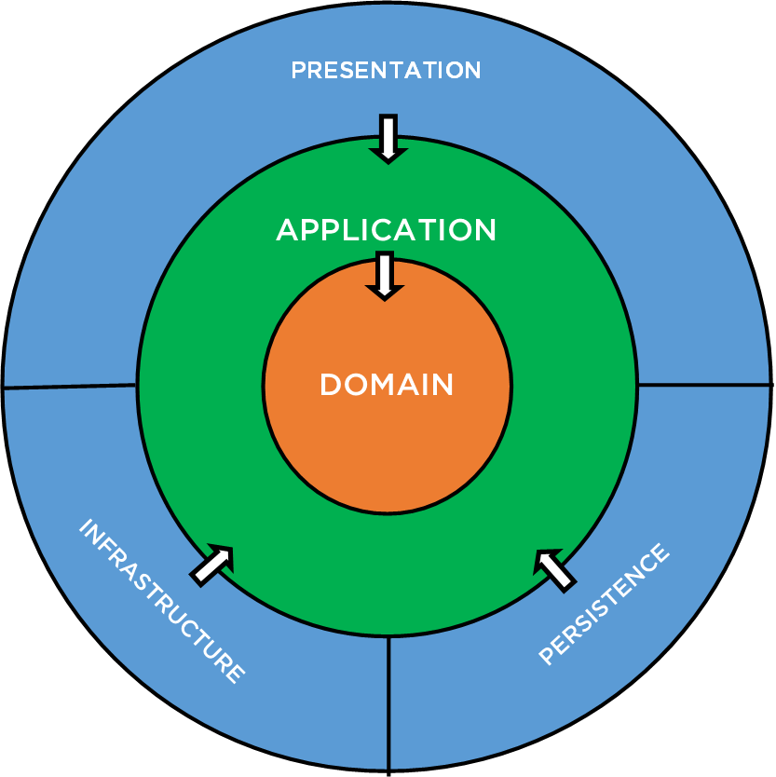
Clean Architecture
Domain
Application
Persistence
Infrastructure
Presentation

Slide 3
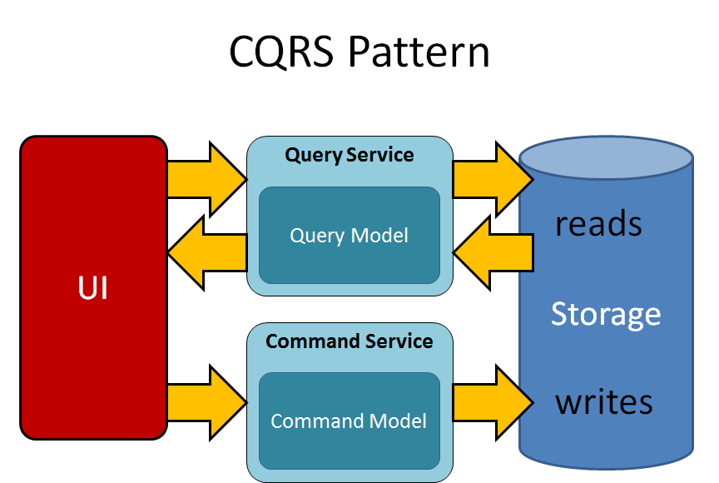

Slide 4
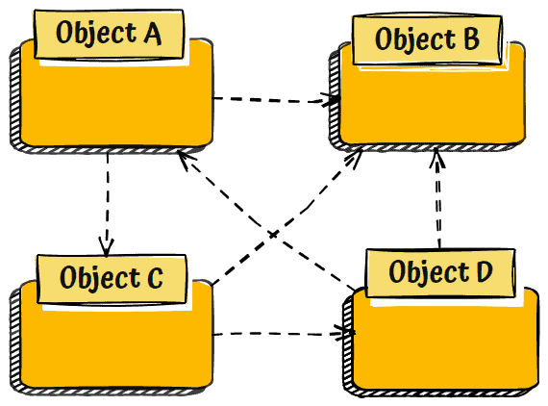
Mediator Pattern

Slide 5
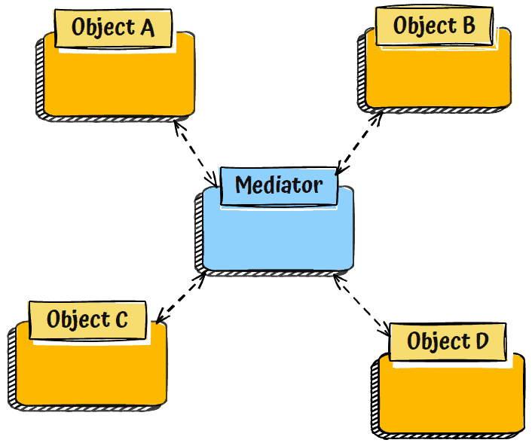

Slide 6
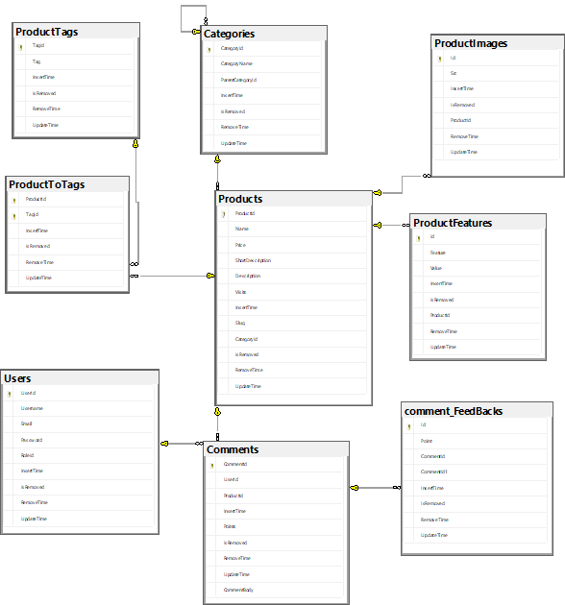
Database Structure

